Slide 1

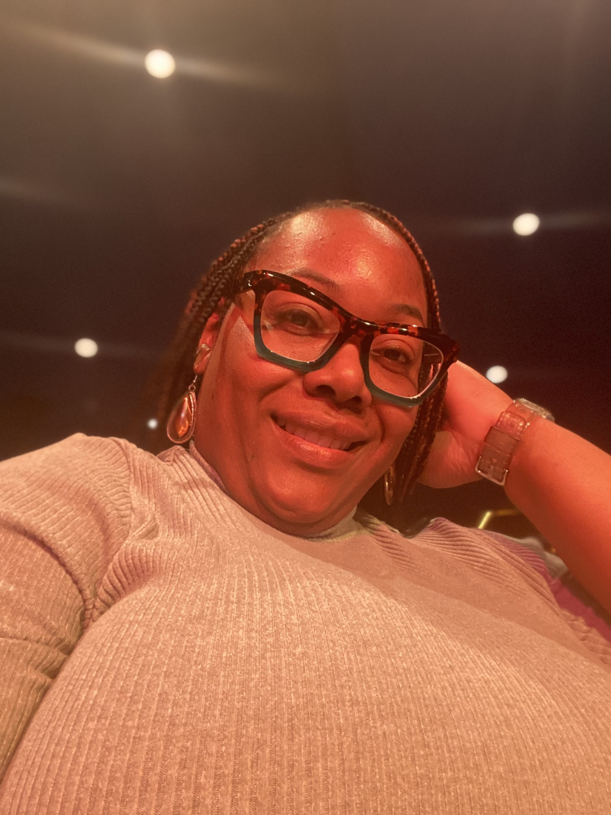

Ms. Harvey
8th Grade Math REP

Slide 2

My Contact Information
Email: HarveJa1@boe.Richmond.k12.ga.us
Google Voice: 762-233-1211
School Number: 706-592-3730
***I prefer to be contacted via Class Dojo.

Slide 3

Daily Schedule
Students may start entering the building at 8:50 am. Dismissal begins at 4:20 pm.
9:20 am – 10:20 am Acceleration
10:20 am – 11:50 am Connections
11:50 am – 12:50 pm 3rd Period (Jones)
12:50 pm – 2:20 pm 4th Period (Jones)
  Lunch is included in 4th Period from 12:50 pm – 1:20 pm.
2:20 pm – 3:20 pm 5th Period (Lowery)
3:20 pm – 4:20 pm 6th Period (Lowery)

Slide 4
CHECKOUT MY WEBSITE TO VIEW THE FOLLOWING INFORMATION
Learn More About Me
Learn More About The Class
Welcome Letter/Supply List
Resources
Additional Information

Slide 5

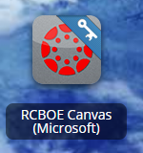
RCSS Learning Platform and Canvas
New to the Richmond County
Go to rcboe.org
Click Student
Click Launch Pad
Watch logging into Canvas as a student.
https://rcboe.instructuremedia.com/embed/048204ea-777e-4c04-9fc0-357111372c96
Your child will login through Launch Pad to access RCBOE Canvas.
Click link to watch Tutorial Video
https://www.rcboe.org/Domain/16265

